Slide 1
Privacy-Preserving Vertical Federated Logistic Regression without Trusted Third-Party Coordinator
Huizhong Sun*, Zhenya Wang, Yuejia Huang, Junda Ye
Beijing University of Posts and Telecommunications , China
ICMLSC 2022
Haikou, January 2022

Slide 2
Ⅰ
Introduction
Ⅱ
Preliminaries
Ⅲ
Our Solution
Contents
Ⅳ
Experiments
Ⅴ
Conclusion

Slide 3
Contents
Introduction
Preliminaries
Our Solution
Introduction
Experiments
Conclusion

Slide 4

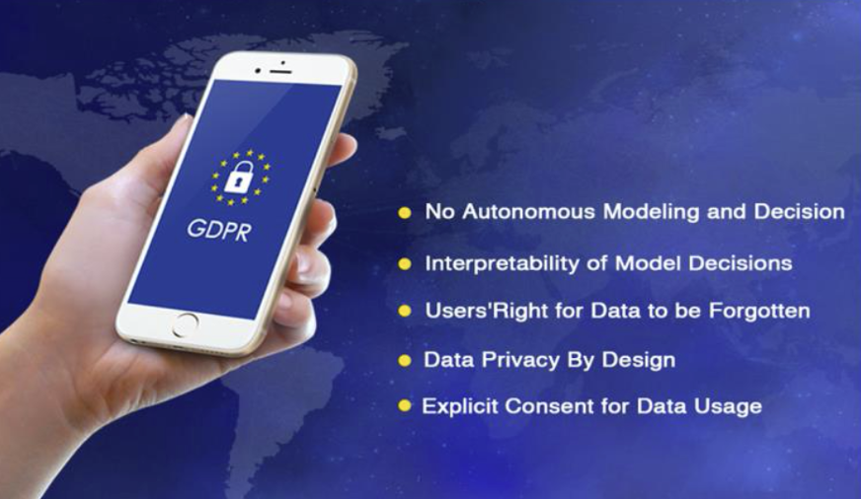
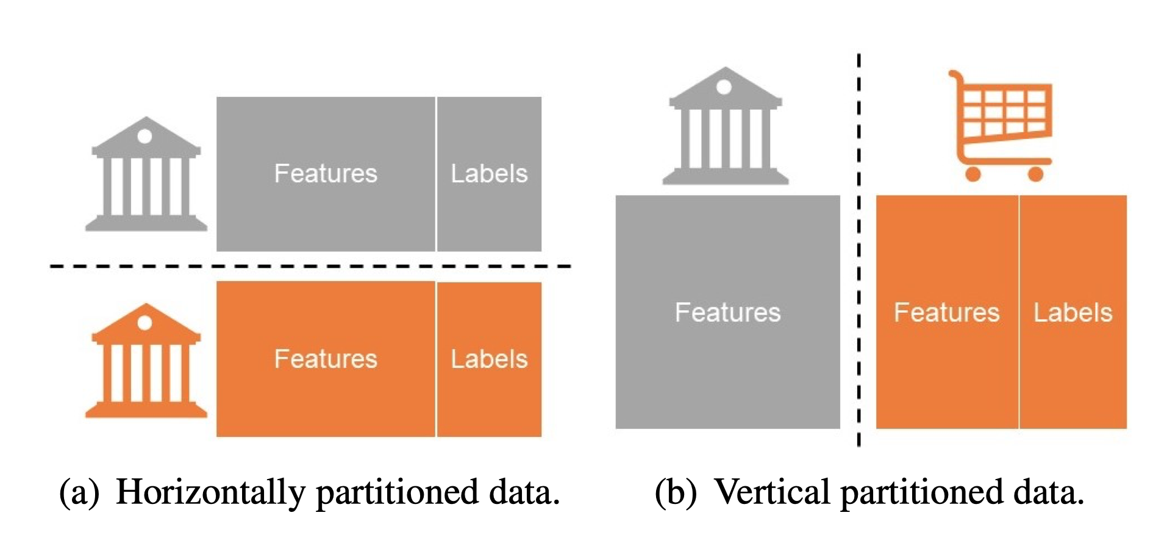
Introduction
Big data and AI develops rapidly, mining data from distributed databases has been a growing interest.
Federated Learning (FL) , collaboratively trains a joint model without exchanging data.
Horizontal Federated Learning (HFL)
Vertical Federated Learning (VFL)
Federated Transfer Learning (FTL)

Slide 5







Introduction
Logistic Regression (LR) is a popular ML model for classification problems, which benefits in simplicity, efficiency and strong interpretability.
In VFL, banks cooperate with e-commerce companies to obtain users’ transaction data, but the data is sensitive, private and valuable, cannot be directly exchanged.
Joint Model
In this work, we study the Privacy-Preserving Vertical Federated Logistic Regression problem (PPVF-LR), which is of great significance.
Directly transmit infomation will cause privacy leakage, use privacy protection technologies like HE and DP to protect.
Insurance
Bank
E-commerce

Slide 6
Introduction
Related Work
Encrypt the original data and distribute the encrypted data to each party, but frequent data encryption and decryption process brings serious efficiency loss. [18]
Gradient calculation based on Taylor series expansion, but the approximation of the loss function will bring about a decrease in accuracy. [11]
Training strategy based on HE without trusted third-party (TTP) , but result in strict training constrains and bring potential privacy leakage. [24]
In some model publishing scenarios, the training data can be inferred through the parameters, DP-SGD is a common framework for ML with DP. [1]

Slide 7
Contents
Introduction
Preliminaries
Our Solution
Preliminaries
Experiments
Conclusion

Slide 8
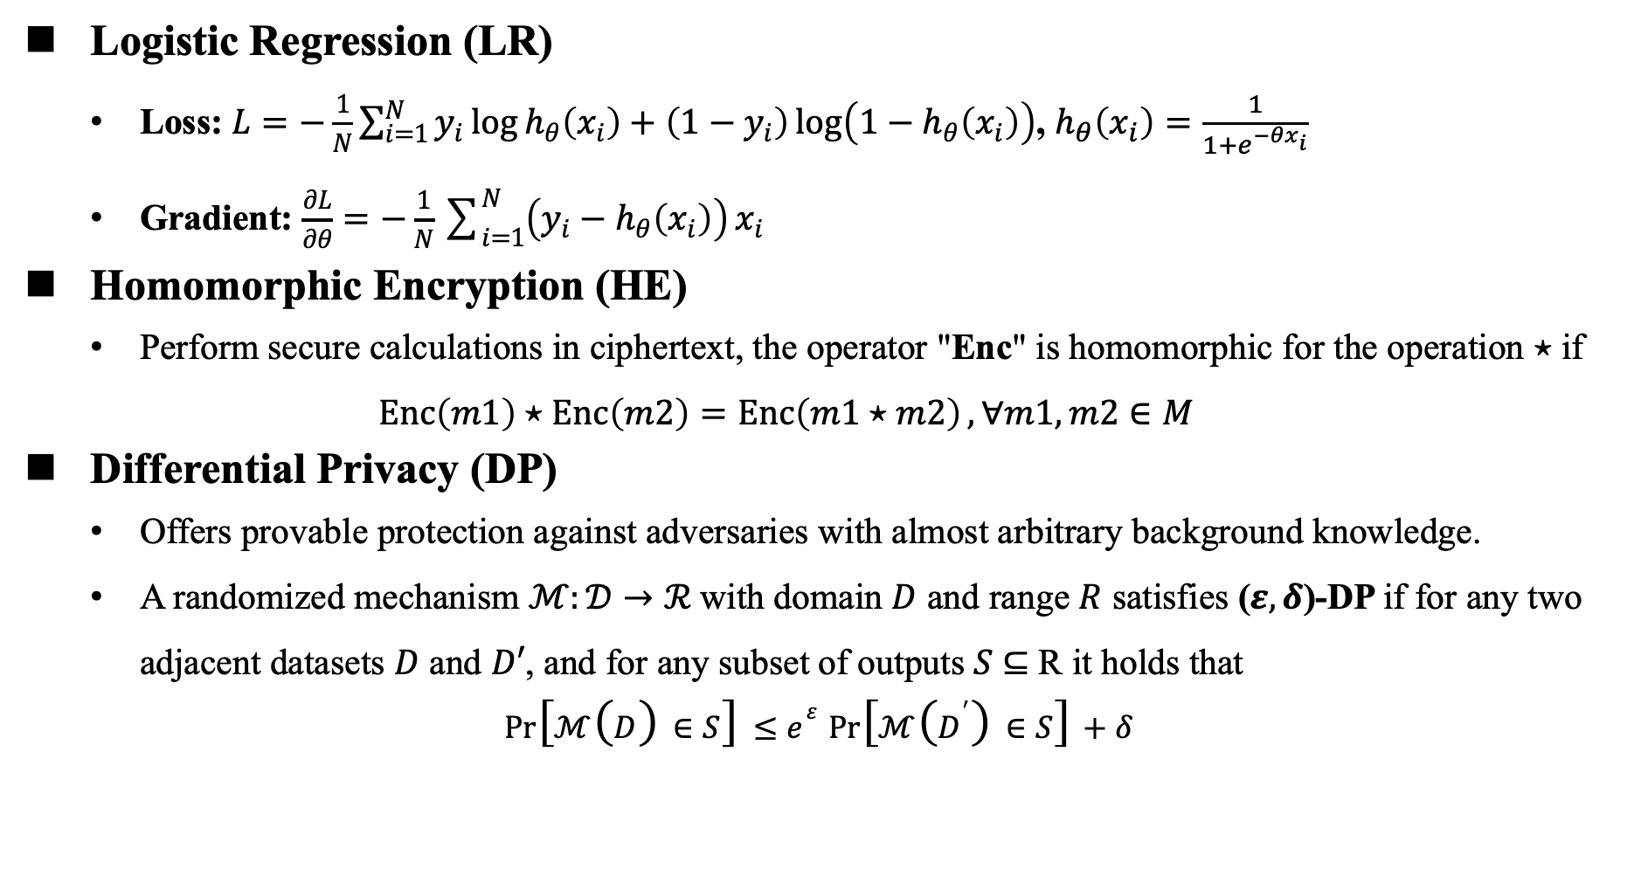
Preliminaries
Logistic Regression (LR)
Loss: $L=−\frac{1}{N}\sum_{i=1}^{N}{y_{i}\log{h_{θ}\left(x_{i}\right)}}+\left(1−y_{i}\right)\log\left(1−h_{θ}\left(x_{i}\right)\right)$, $h_{θ}\left(x_{i}\right)=\frac{1}{1+e^{−θx_{i}}}$
Gradient: $\frac{∂L}{∂θ}=−\frac{1}{N}\sum_{i=1}^{N}{\left(y_{i}−h_{θ}\left(x_{i}\right)\right)}x_{i}$
Homomorphic Encryption (HE)
Perform secure calculations in ciphertext, the operator "Enc" is homomorphic for the operation ⋆ if
$$\operatorname{Enc}\left(m1\right)⋆\operatorname{Enc}\left(m2\right)=\operatorname{Enc}\left(m1⋆m2\right),∀m1,m2∈M$$
Differential Privacy (DP)
Offers provable protection against adversaries with almost arbitrary background knowledge.
A randomized mechanism $ℳ:𝒟→ℛ$with domain $D$ and range $R$ satisfies ($ε, δ$)-DP if for any two adjacent datasets $D$ and $D′$, and for any subset of outputs 𝑆 ⊆ R it holds that
$$\begin{aligned}\operatorname{Pr}\left[ℳ\left(D\right)∈S\right]≤e^{ε}\operatorname{Pr}\left[ℳ\left(D^{′}\right)∈S\right]+δ \end{aligned}$$

Slide 9






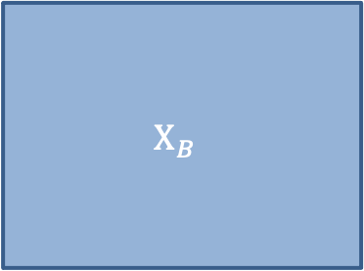
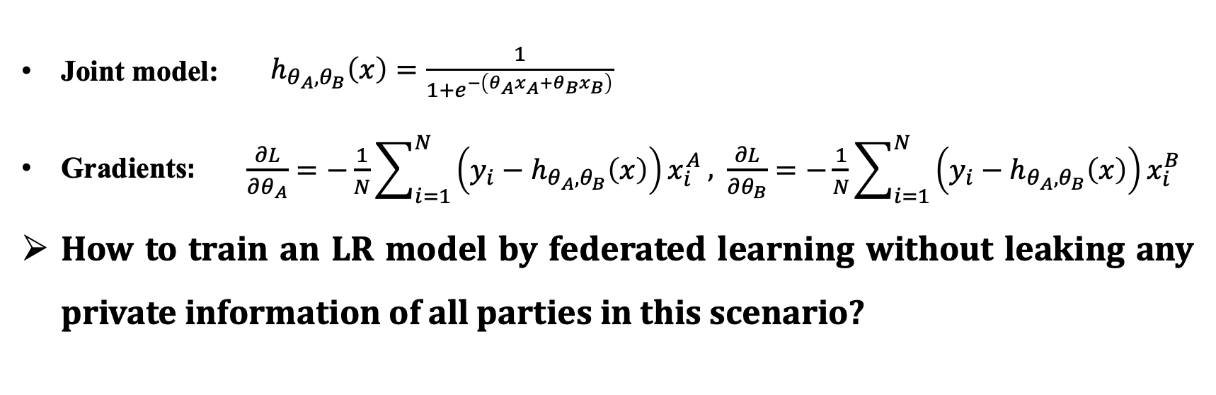


Preliminaries
Problem Definition (take two parties for example)
$$d_{A}$$
$$d_{B}$$
$$X_{B}$$
$$y$$
$$n$$
$$X_{A}$$
$$n$$
Label
$$θ_{A}$$
$$θ_{B}$$
Party A
Party B
Joint model: $\begin{aligned}h_{θ_{A},θ_{B}}\left(x\right)=\frac{1}{1+e^{−\left(θ_{A}x_{A}+θ_{B}x_{B}\right)}}\#\end{aligned}$
Gradients: $\begin{aligned}\frac{∂L}{∂θ_{A}}=−\frac{1}{N}\sum_{i=1}^{N}{\left(y_{i}−h_{θ_{A},θ_{B}}\left(x\right)\right)}x_{i}^{A} \#\end{aligned}$, $\begin{aligned}\frac{∂L}{∂θ_{B}}=−\frac{1}{N}\sum_{i=1}^{N}{\left(y_{i}−h_{θ_{A},θ_{B}}\left(x\right)\right)}x_{i}^{B}\#\end{aligned}$
How to train an LR model by federated learning without leaking any private information of all parties in this scenario?

Slide 10
Contents
Introduction
Preliminaries
Our Solution
Our Solution
Experiments
Conclusion

Slide 11





Our Solution
Overview
PPVF Model Training for LR
PPVF Final
Model for LR
Homomorphic Encryption (HE),
Differential Privacy (DP), etc
PPVF-LR Model Training Algorithm
Training locally
No data transmission
Party A
Party B
Privacy-Preserving Vertical Federated (PPVF) Logistic Regression
without a Third Party

Slide 12
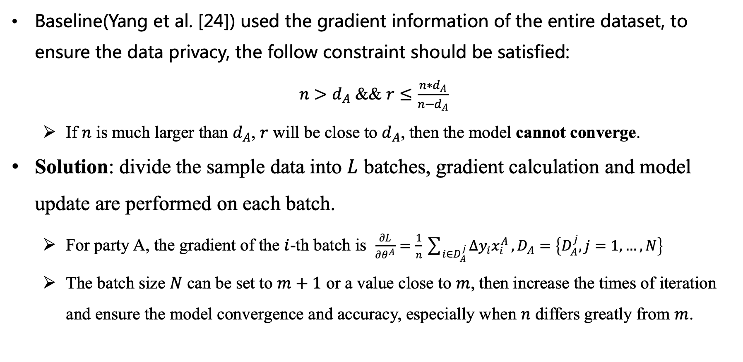
Our Solution
Mini-batch SGD-based Model Training Method
Baseline(Yang et al. [24]) used the gradient information of the entire dataset, to ensure the data privacy, the follow constraint should be satisfied:
$n>d_{A}$ && $r≤\frac{n∗d_{A}}{n−d_{A}}$
If $n$ is much larger than $d_{A}$, $r$ will be close to $d_{A}$, then the model cannot converge.
Solution: divide the sample data into $L$ batches, gradient calculation and model update are performed on each batch.
For party A, the gradient of the $i$-th batch is $\frac{∂L}{∂θ^{A}}=\frac{1}{n}\sum_{i∈D_{A}^{j}}{Δy_{i}x_{i}^{A}},D_{A}=\left\{D_{A}^{j},j=1,…,N\right\}$
The batch size $N$ can be set to $m+1$ or a value close to $m$, then increase the times of iteration and ensure the model convergence and accuracy, especially when $n$ differs greatly from $m$.

Slide 13
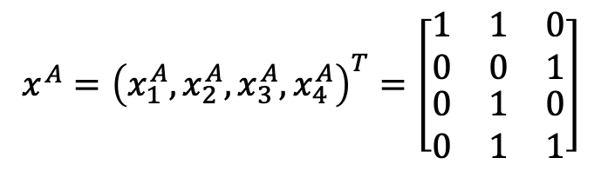
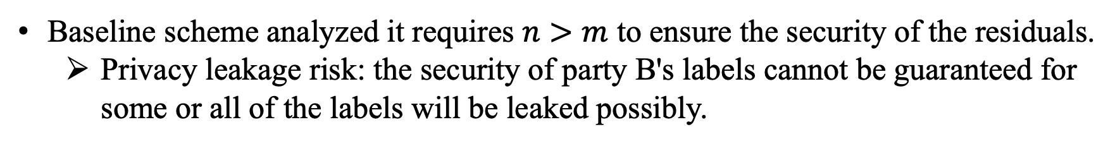
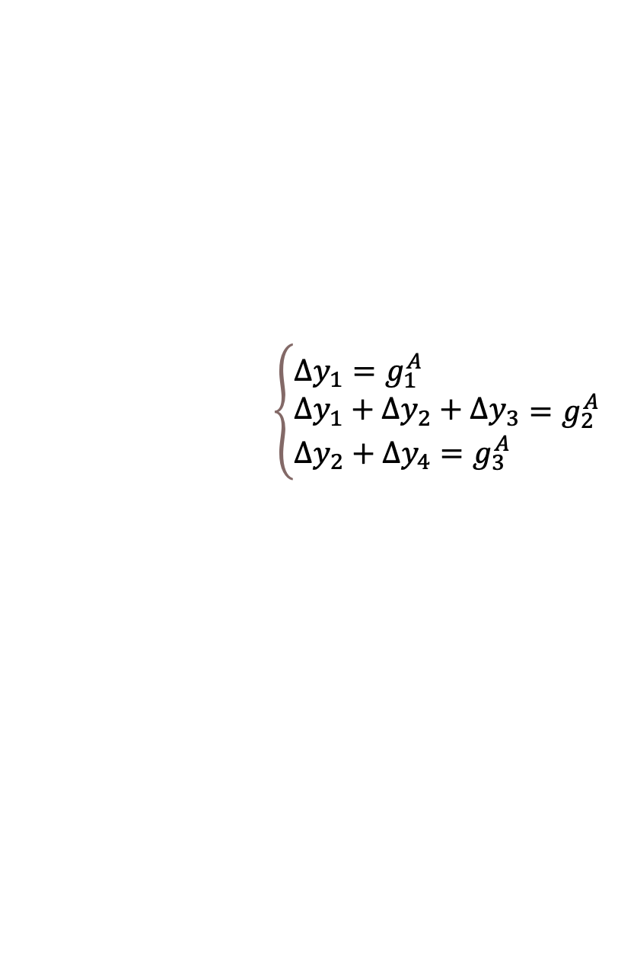
Our Solution
HE-based Parameter Updating Scheme
Baseline scheme analyzed it requires $n>m$ to ensure the security of the residuals.
Privacy leakage risk: the security of party B's labels cannot be guaranteed for some or all of the labels will be leaked possibly.
$$x^{A}={\left(x_{1}^{A},x_{2}^{A},x_{3}^{A},x_{4}^{A}\right)}^{T}=\left[\begin{matrix}\begin{matrix}1 & 1 & 0 \\ 0 & 0 & 1\end{matrix} \\ \begin{matrix}0 & 1 & 0 \\ 0 & 1 & 1\end{matrix}\end{matrix}\right]$$
$$\left\{\begin{aligned}&∆y_{1}=g_{1}^{A} \\ &∆y_{1}+∆y_{2}+∆y_{3} \\ &∆y_{2}+∆y_{4}=g_{3}^{A} \end{aligned}=g_{2}^{A}\right.$$
Solution: the parameters are encrypted during the entire training process, thus party A cannot obtain any intermediate result and parameters.
Besides, in our scheme, the model parameters are unknowable to party A which avoids the ‘knowledge’ leakage of party B.

Slide 14
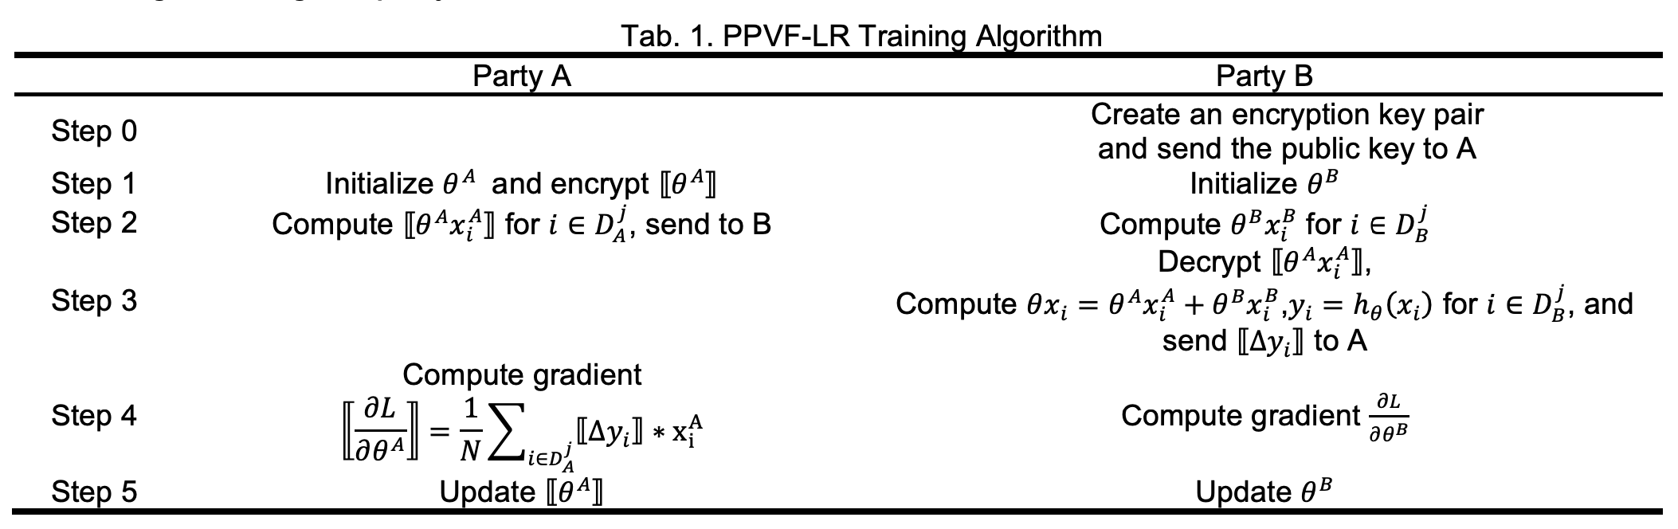
Our Solution
HE-based Parameter Updating Scheme
PPVF-LR Training Algorithm

Slide 15
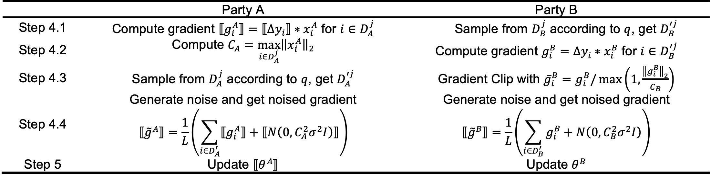
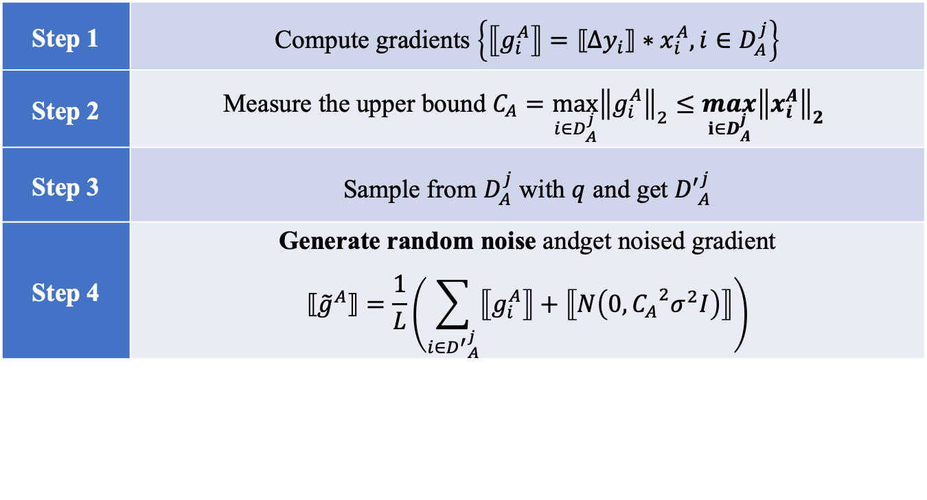
Our Solution
DP-based Parameter Privacy Protection
隐私分析：
Batch内采样，MA机制分析串行隐私消耗
Batch间并行，并行机制保证整体隐私
For the privacy leakage risk in the model publishing scenario, we design a noise adding mechanism and prove it satisfies DP through privacy analysis.
Focus:
(1) How to reduce the impact of noise in the limited iteration rounds and ensure the training algorithm satisfies DP?
(2) How to measure the sensitivity in ciphertext to design reasonable noise?
Solution:
Step 1 | Compute gradients $\left\{⟦g_{i}^{A}⟧=⟦∆y_{i}⟧∗x_{i}^{A}, i∈D_{A}^{j}\right\}$
Step 2 | Measure the upper bound $C_{A}=\max_{i∈D_{A}^{j}}{{\left\|g_{i}^{A}\right\|}_{2}}≤\max_{i∈D_{A}^{j}}{{\left\|x_{i}^{A}\right\|}_{2}}$
Step 3 | Sample from $D_{A}^{j}$ with $q$ and get ${D′}_{A}^{j}$
Step 4 | Generate random noise andget noised gradient $$⟦{\tilde{g}}^{A}⟧=\frac{1}{L}\left(\sum_{i∈{D^{′}}_{A}^{j}}{⟦g_{i}^{A}⟧}+⟦N\left(0, {C_{A}}^{2}σ^{2}I\right)⟧\right)$$

Slide 16
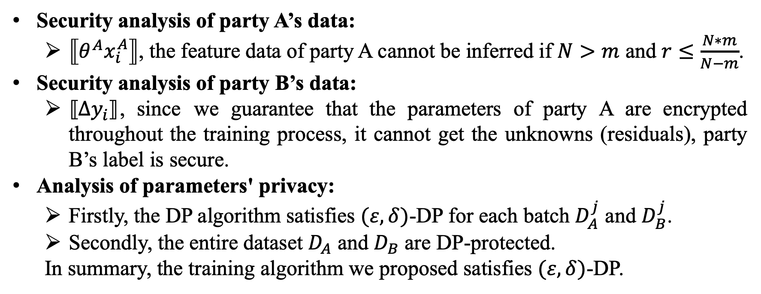
Our Solution
Security Analysis
Security analysis of party A’s data:
$⟦θ^{A}x_{i}^{A}⟧$, the feature data of party A cannot be inferred if $N>m$ and $r≤\frac{N∗m}{N−m}$.
Security analysis of party B’s data:
$⟦Δy_{i}⟧$, since we guarantee that the parameters of party A are encrypted throughout the training process, it cannot get the unknowns (residuals), party B’s label is secure.
Analysis of parameters' privacy:
Firstly, the DP algorithm satisfies $(ε, δ)$-DP for each batch $D_{A}^{j}$ and $D_{B}^{j}$.
Secondly, the entire dataset $D_{A}$ and $D_{B}$ are DP-protected.
In summary, the training algorithm we proposed satisfies $(ε, δ)$-DP.

Slide 17
Contents
Introduction
Preliminaries
Our Solution
Experiments
Experiments
Conclusion

Slide 18
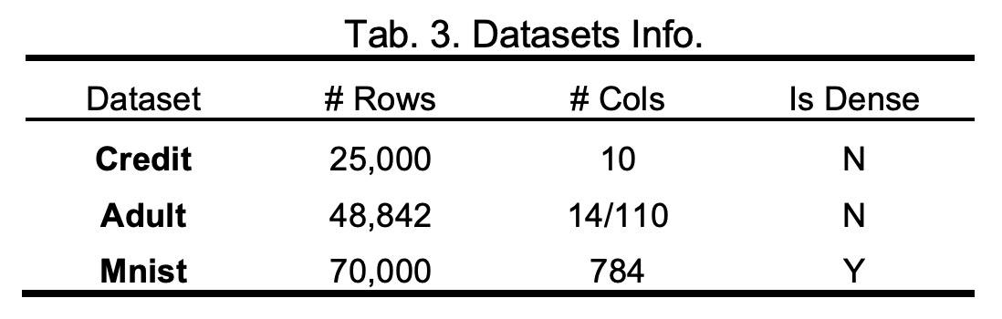
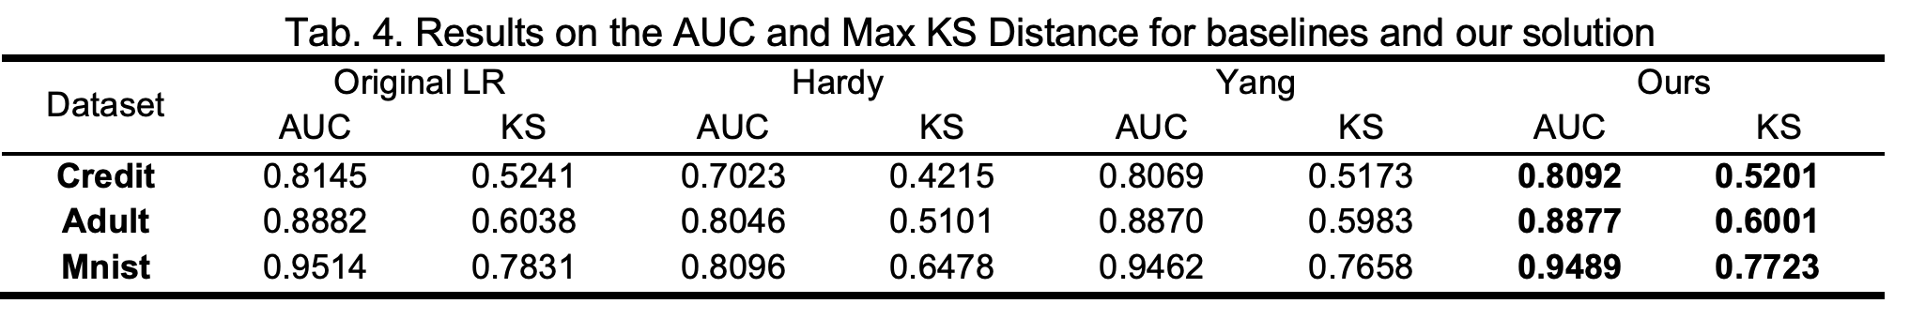
Experiments
Datasets: Credit, Adult, Mnist
Baseline Method: Original LR [12], Hardy [11], and Yang [24].
Evaluation Metric: AUC & maximum Kolmogorov-Smirnov (KS).
For features are averagely divided

Slide 19
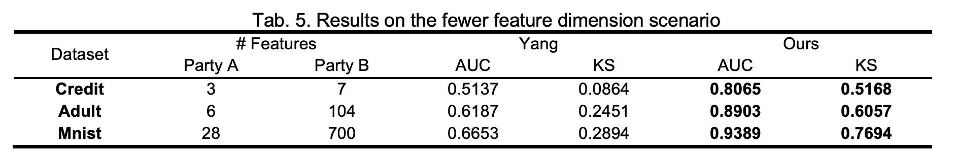
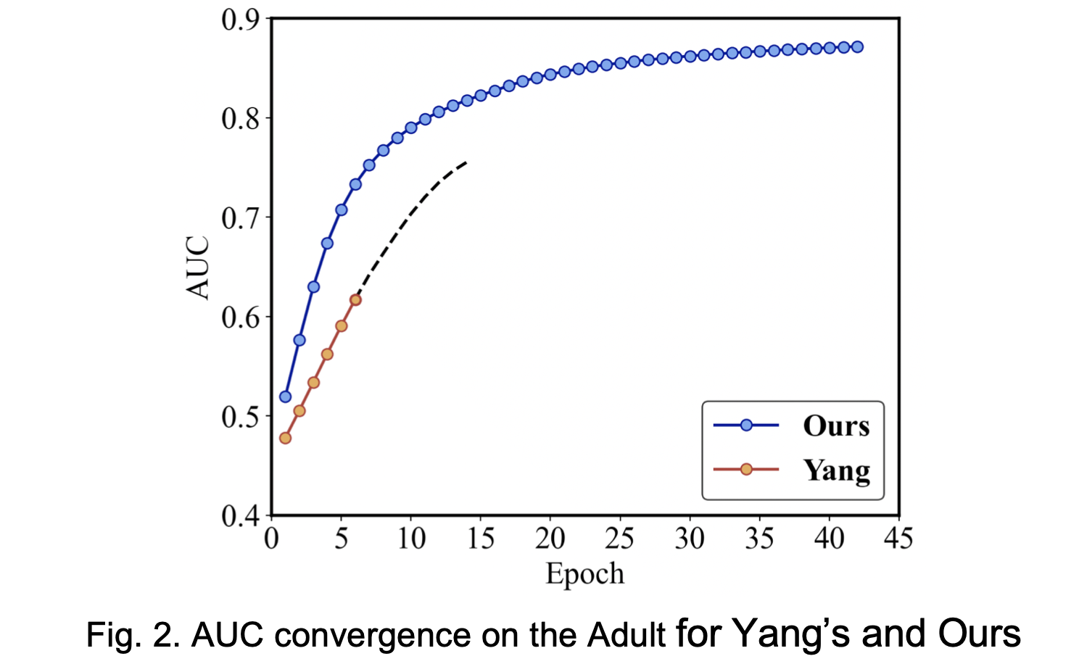
Experiments
For the data provider with fewer features

Slide 20
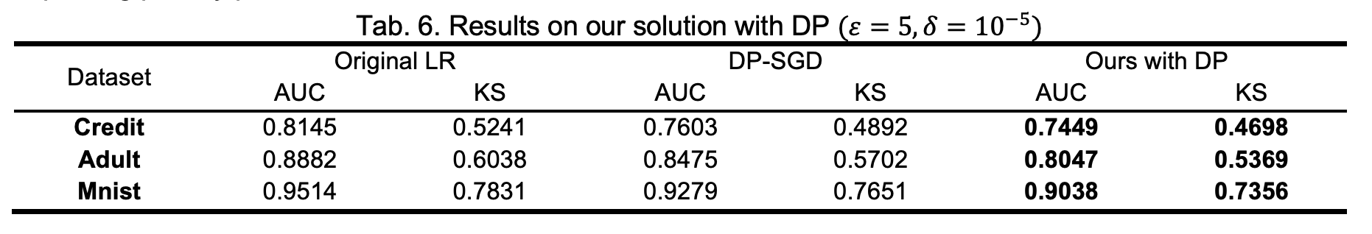
Experiments
For the algorithm scheme of DP
Our solution with DP reduces the model utility loss by less than 3% compared with the data concentration scenario, which can ensure the model utility while improving privacy protection.

Slide 21
Contents
Introduction
Preliminaries
Our Solution
Conclusion
Experiments
Conclusion

Slide 22
Conclusion
In this paper, we propose a vertical federated learning algorithm for logistic regression that does not require a trusted third party.
With the mini-batch SGD-based training method and the HE-based parameter updating scheme, we alleviate the constraints on sample feature dimensions and improve the security of the model training process.
By applying DP on the model parameters, we ensure the data privacy of all parties.
Through rigorous security analysis, we prove that the scheme we proposed can provide strict privacy protection.
Future Work
Optimization of efficiency
More complex neural networks
LR’s applications, such as credit scorecards
…

Slide 23
Thanks for listening!

